Slide 1

AIRBNB HOTEL BOOKING ANALYSIS
Name: Vivek Suresh Lokolakar
AICTE Internship ID: STU6717b01043d191729605648
Internship ID: INTERNSHIP_172663295366ea53f910591

Slide 2

PROBLEM STATEMENT
The rapid growth of Airbnb has generated massive amounts of booking data. However, analyzing this data to understand customer behavior, booking patterns, and market trends is challenging. The lack of insights can lead to poor decision-making by hosts and missed opportunities for travelers and the platform.

Slide 3
Project Description This project analyzes Airbnb booking data to identify: - Seasonal booking trends - Popular room types and locations - Pricing strategies and customer preferences - Cancellation patterns and their impact The objective is to provide actionable insights that improve host revenue strategies, enhance customer experience, and support Airbnb’s platform management.

Slide 4

WHO ARE THE END USERS?
Airbnb Hosts → to optimize pricing, availability, and property listings.
Travelers → to identify the best times and places to book accommodations.
Airbnb Platform Managers → to monitor market dynamics and improve platform policies.
Researchers/Analysts → to study booking behaviors and travel trends.

Slide 5

Technology Used
Programming Language: Python.
Libraries: Pandas, NumPy, Matplotlib, Seaborn, Plotly.
Data Source: Airbnb booking dataset.
Tools: Jupyter Notebook for analysis and visualization.
Software: Google Colab or Vs code.

Slide 6
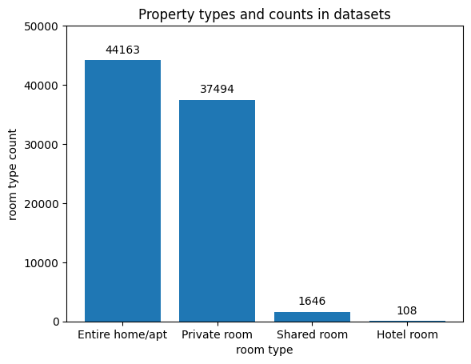
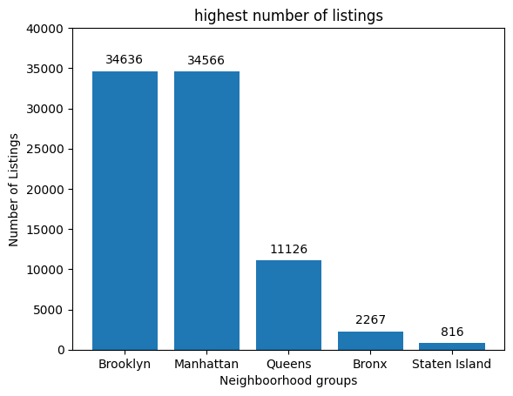
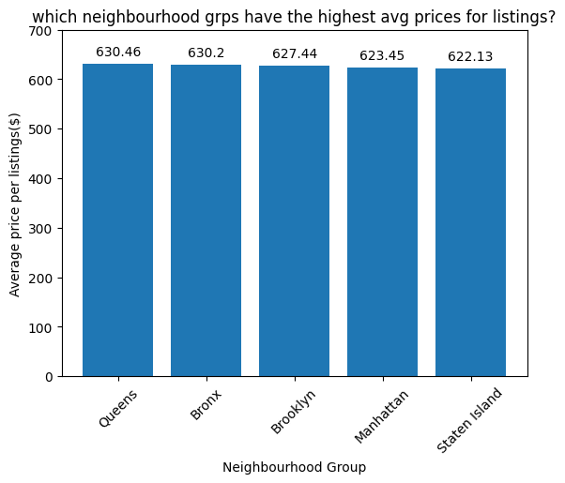
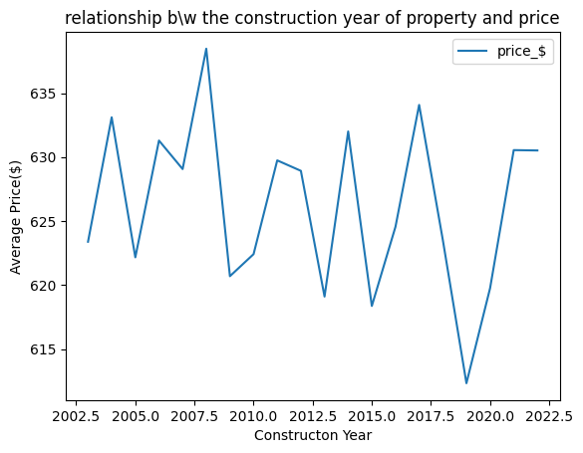
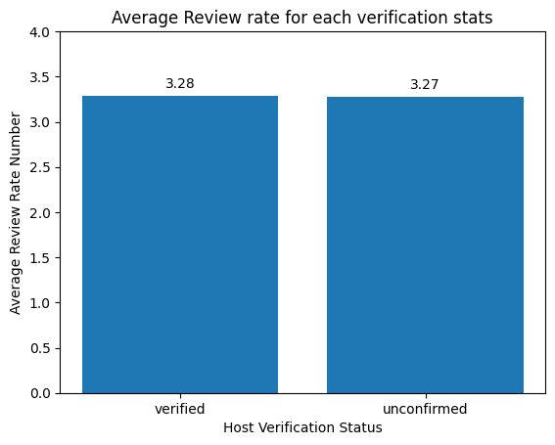
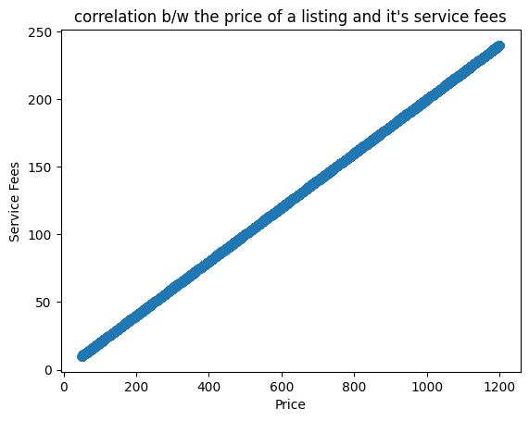
RESULTS1

Slide 7
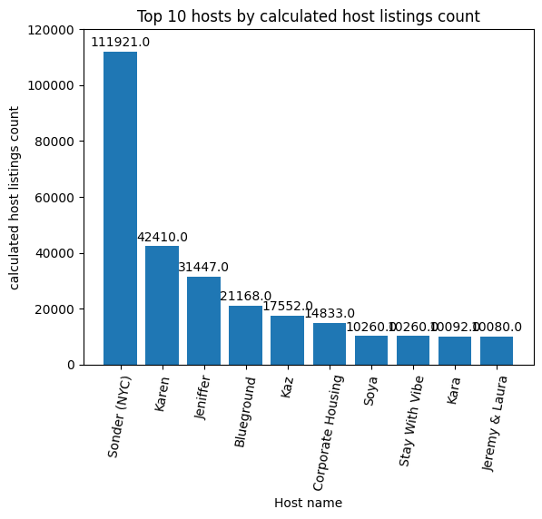
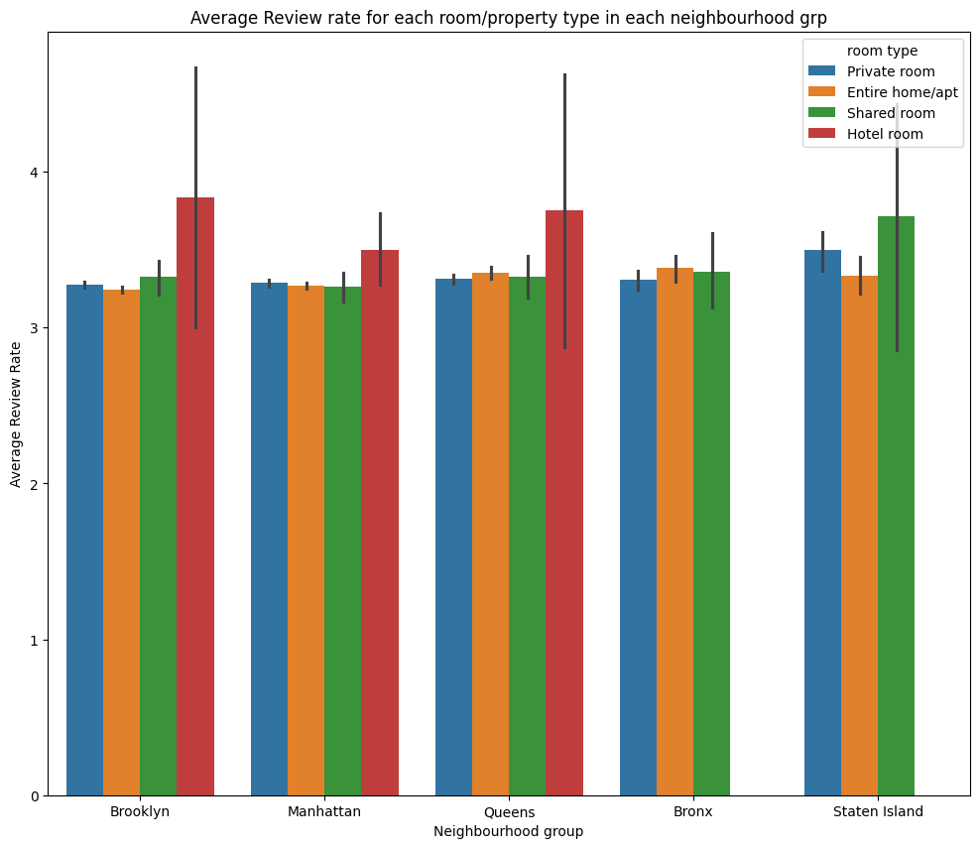
RESULTS2

Slide 8
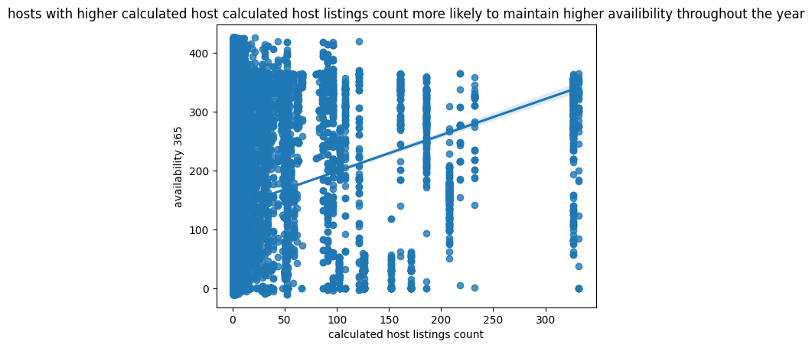
RESULTS3

Slide 9
GitHub repository
Github Project repository:
https://github.com/vivek8085/VOIS_AICTE_Oct2025_Vivek-Suresh-Lokolakar.git

Slide 10

Getting started with Basics of Python Certificate

Slide 11
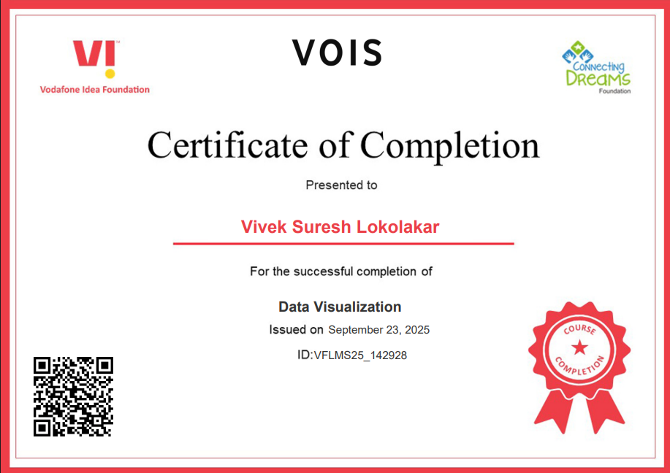
Data Visualization Certificate

Slide 12
Thank you
.
.

